Slide 1
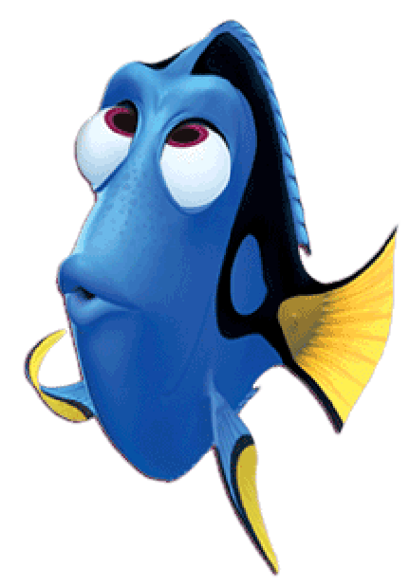
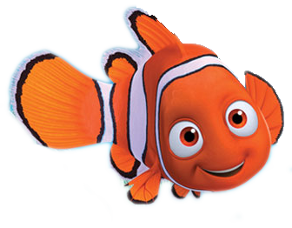
Can you help me find my friend Dory?

Slide 2
Want to know a secret?

Slide 3
Dory likes
JUMPING red circles.

Slide 4
Which one is the red circle?

Slide 5
GREAT JOB!

Slide 6
What color is the other circle?

Slide 7
JUMPING circles
move up and down!

Slide 8
Let’s find all of
the JUMPING red circles!

Slide 9
Can you help me find my friend Dory?

Slide 10
Want to know a secret?

Slide 11
Dory likes
JUMPING black circles.

Slide 12
Which one is the black circle?

Slide 13
GREAT JOB!

Slide 14
What color is the other circle?

Slide 15
JUMPING circles
move up and down!

Slide 16
Let’s find all of the
JUMPING black circles!

